Slide 1


Slide 2

All Your Cyber Security Needs
Foundation Technology
Our new Anti-Virus protection system
December 2099

Slide 3
Our Life Becomes Incresingly digital
We store data, memories, pictures and personal data on our devices.
Notes:
Slide 3: Situation
Title: The Digital Age Content: Our lives are increasingly digital, with critical personal and business data stored online. This digital dependence requires strong protection.

Slide 4
Our Life Becomes Incresingly digital
We store data, memories, pictures and personal data on our devices.
Notes:
Slide 4: Situation
Title: Storing in the cloud

Slide 5
1. Use a Line chart with markers
1. Delete gridlines
Add in mln units and years / date text
2. Display less horizontal values (Axis Options -> Axis Type -> Date Axis
Consider putting the vertical axis on the right side (Horizontal Axis Options -> Vertical Axis Crosses -> At Maximum Date
Re-color the line
Add nice colors
Constant growth of Virus Attacks!
Blocked attacks measured between 2080 and 2096 on one example device
No of attacks in mln
Ever Growing
60m+
Year
Notes:
Slide 2: Complication
Title: Growing Cyber Threats Content: Cyber threats like malware, ransomware, and viruses are more prevalent and sophisticated. Number of attacks growing

Slide 6

What happens…
20 years
1100%
Notes:
Slide 4: Situation
Title: Storing in the cloud

Slide 7
What happens…
20 years
1100%
In another 20?
Notes:
Slide 4: Situation
Title: Storing in the cloud

Slide 8
How do we Protect Our Data?
Different ways of protecting your data include cautioun, software and storage
Being
cautious
Dedicated
software
Trusted security companies
Notes:
Slide: Question
Title: How Do We Protect Our Data? Content: We could thread carefully with our data, we could use dedicated anti-virus software or we can outsource security to other companies

Slide 9
How do we Protect Our Data?
Different ways of protecting your data include cautioun, software and storage
Being
cautious
Trusted security companies
Dedicated
software
Notes:
Slide: Question
Title: How Do We Protect Our Data? Content: We could thread carefully with our data, we could use dedicated anti-virus software or we can outsource security to other companies

Slide 10
How do we Protect Our Data?
Different ways of protecting your data include cautioun, software and storage
WallSafe
Dedicated anti-virus
Software with 100%
Block rate
Being
cautious
Trusted security companies
Dedicated
software
Notes:
Slide: Question
Title: How Do We Protect Our Data? Content: We could thread carefully with our data, we could use dedicated anti-virus software or we can outsource security to other companies

Slide 11
Distinctive features of WallSafe
Attacks are stopped before they happen
Regular Anti-Virus
WallSafe
99%
100%

Slide 12
Unique Pricing Model
Upfront
Pay-as-you-block
$9,99 or more
$1 per 1mln
$9,99 limit
99% security
100% security
Notes:
Why we stand out #2 – Unique Pricing Model – Pay as you go

Slide 13
Comprehensive
Virus, malware,
Exploits and more
Real-Time
Software always runs in backgrdound
All Devices
Full security
Of your data
Notes:
Slide x: Benefits and Call to Action
Title: Secure Your Digital Life Content: Benefit from comprehensive protection, real-time threat detection, and peace of mind. Start protecting your devices today!

Slide 14
Comprehensive
Virus, malware,
Exploits and more
Real-Time
Software always runs in backgrdound
All Devices
Full security
Of your data
Notes:
Slide x: Benefits and Call to Action
Title: Secure Your Digital Life Content: Benefit from comprehensive protection, real-time threat detection, and peace of mind. Start protecting your devices today!

Slide 15
Comprehensive
Virus, malware,
Exploits and more
Real-Time
Software always runs in backgrdound
All Devices
Full security
Of your data
Notes:
Slide x: Benefits and Call to Action
Title: Secure Your Digital Life Content: Benefit from comprehensive protection, real-time threat detection, and peace of mind. Start protecting your devices today!

Slide 16
Comprehensive
Virus, malware,
Exploits and more
Real-Time
Software always runs in backgrdound
All Devices
Full security
Of your data
Notes:
Slide x: Benefits and Call to Action
Title: Secure Your Digital Life Content: Benefit from comprehensive protection, real-time threat detection, and peace of mind. Start protecting your devices today!

Slide 17

Comprehensive
Get
started
Virus, malware,
Exploits and more
Real-Time
Software always runs in backgrdound
Visit Website
All Devices
Full security
Of your data
Notes:
Slide x: Benefits and Call to Action
Title: Secure Your Digital Life Content: Benefit from comprehensive protection, real-time threat detection, and peace of mind. Start protecting your devices today!

Slide 18













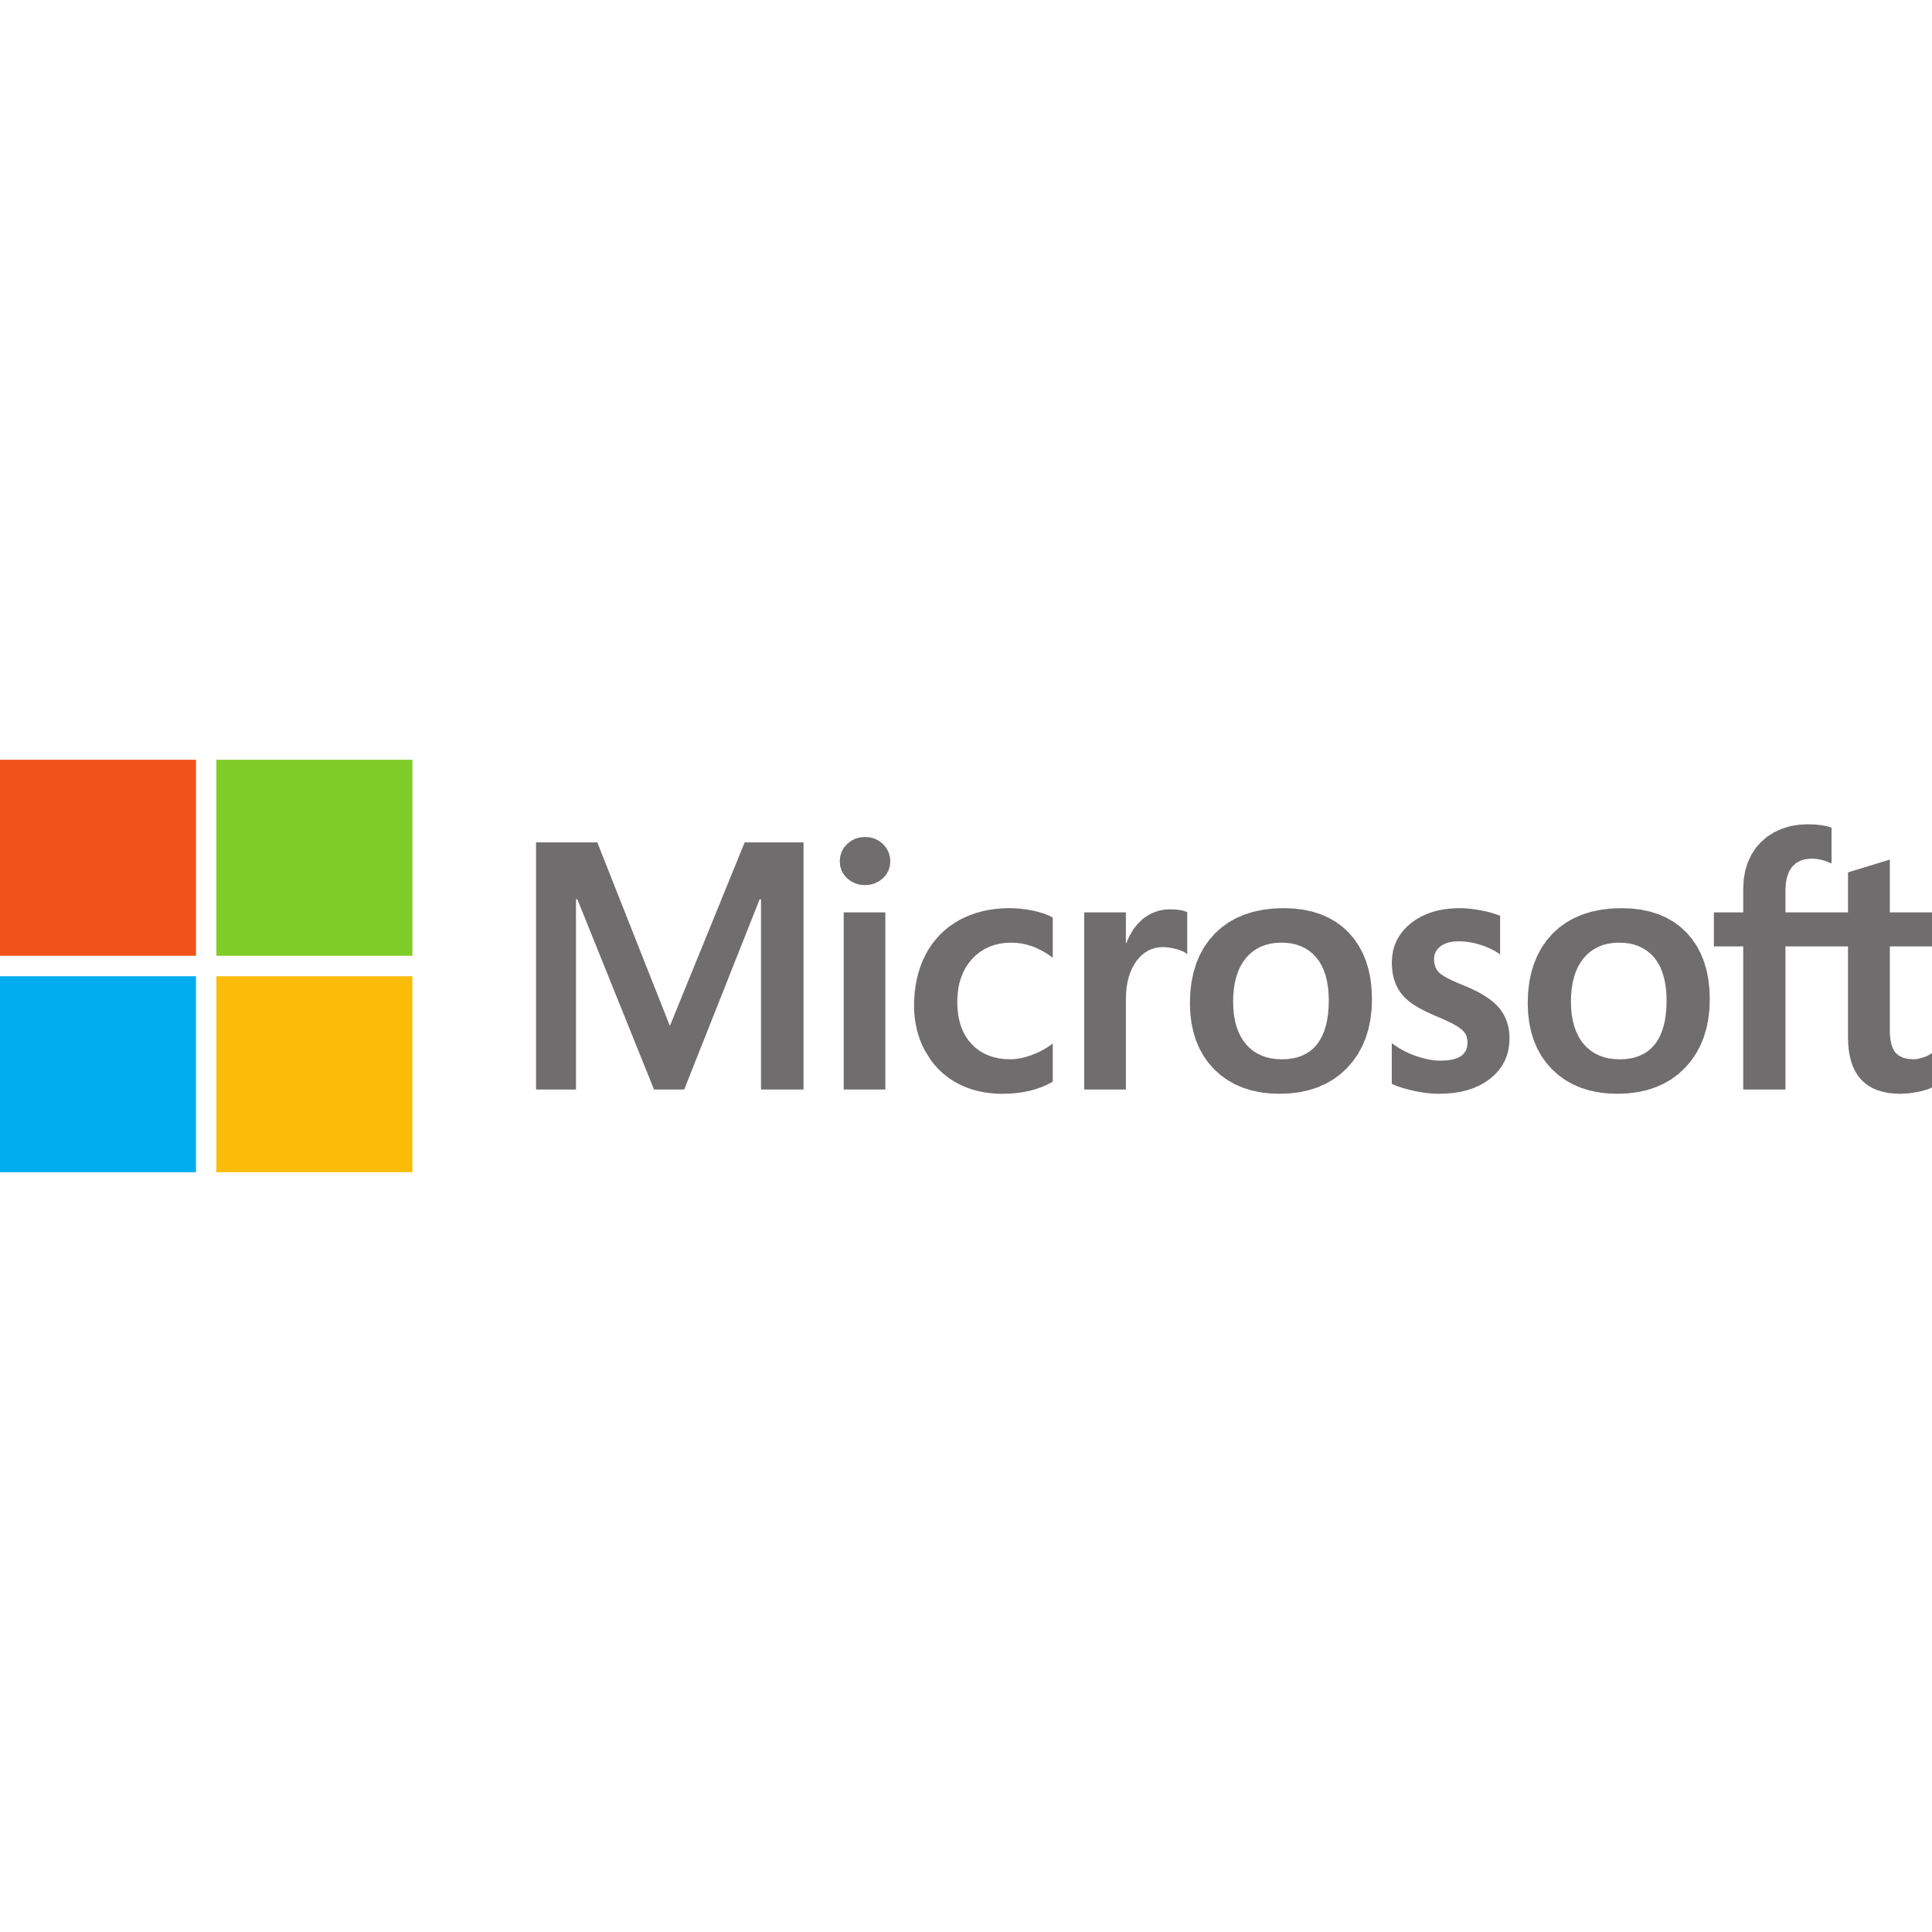

Our Solution is Trusted by

Slide 19
Our Solution is Trusted by

Slide 20

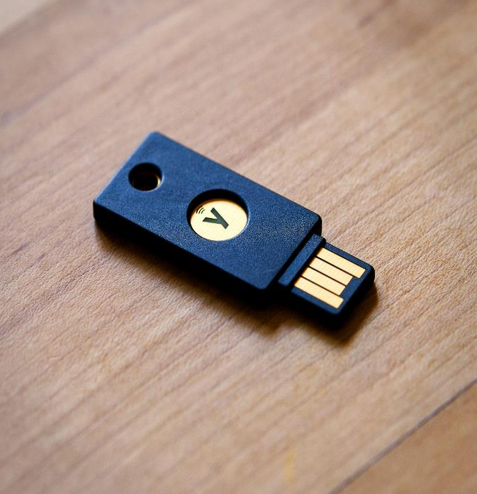
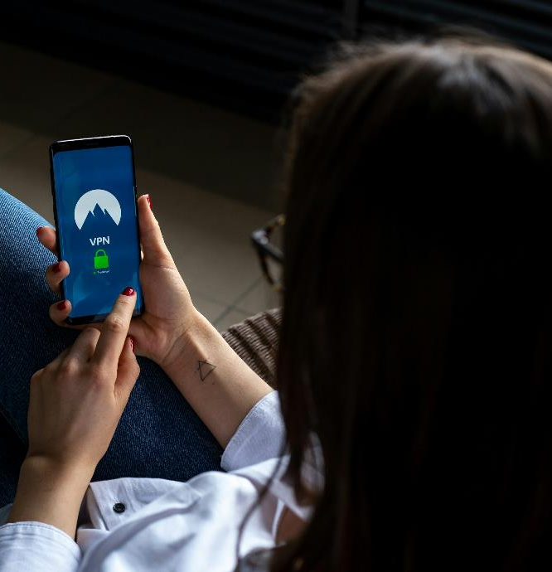
More about Foundation Technology
Get to know us before working with us
We care about the privacy of our users.
Our company takes customer satisfaction
as a priority.
Up to date
Qualified Workforce
Following Trends
Our database is updated
24/7, no failures.
We hire best IT specialist in the filed
We are signed with 3rd party virus update providers

Slide 21
Open
For questions

Slide 22
Thank you
WallSafe
WallSafe Anti-Virus protection system
December 2099

Slide 23
Brand book
#7C0DFF
#9C5EF2
#C4A2F2
#5005F2
#6CF1D6
#15D9AF
#F2F2F2

Slide 24
Icons

Slide 25
Logos

Slide 26
